Slide 1

Facts behind Fantasy: Dissecting the Captivating World of Korean Dramas
Team Members: Mingyang, Michelle, Hannie, Ethan
Notes:
Good evening everyone! (annyeonghaseyo)! We are Ming Yang, Michelle, Ethan, and Hannie! Let me ask you, are you a sucker for heart-fluttering romances, tear-jerking melodramas, and jaw-dropping plot twists? If you are, sit back and relax as we uncover the facts behind fantasy by dissecting the captivating world of kdramas.

Slide 2





Slide 3
Data and Methods
Dataset
https://www.kaggle.com/datasets/ahbab911/top-250-korean-dramas-kdrama-dataset
Dataset of the top 250 kdramas for the past 20 years
Include titles, genres, actors, directors, ratings, year of release, duration, and more
Methods
Python: pandas, seaborn, wordcloud, matplotlib, scikit learn
R: ggplot, dplyr, tidyr
Notes:
Our dataset is obtained from kaggle which has information of the top 250 kdramas for the past 20 years together with other information such as genre, actors, directors, length of episodes and many more. We also mainly used python and r to do our data analysis and visualizations.

Slide 4
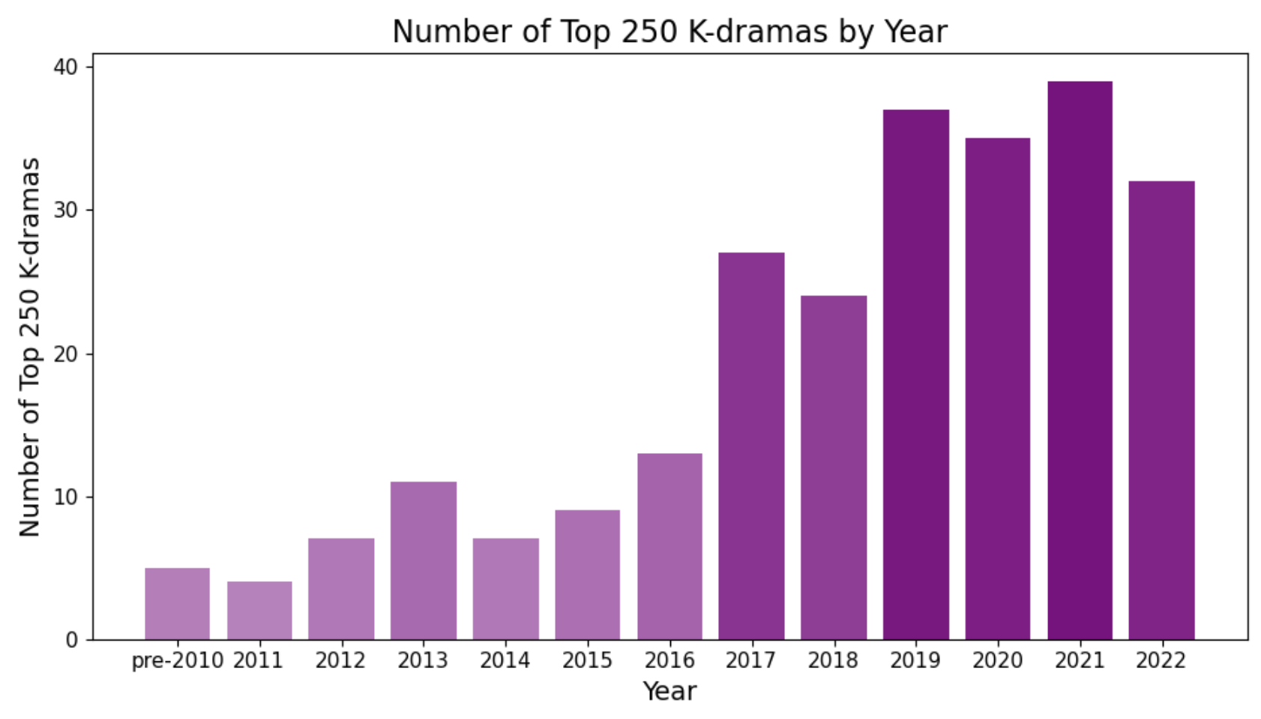
Increase in popularity of kdramas over the years
Notes:
As you can tell from the graph below from the pre-2010s to 2022, there is definitely an increase in the popularity of kdramas.

Slide 5


2010s…
Notes:
A tidal wave of drama madness started in the 2010s as we are swept off our feet by the epic love story of “Heir” starring Lee Min Ho and Park Shin Hye or the unforgettable chemistry between Park Seo Joon and Park Min Young in “what’s wrong with secretary kim?”

Slide 6


BAM!!! It’s the 2020s…
Notes:
And BAM! It’s the 2020s! Who can forget the crazy love story in “Crash Landing on You” or the gripping storyline in “Itaewon Class”? With their captivating storylines and charming oppas, it is no wonder kdramas are gaining popularity over the years. That brings us to the next topic, what are people’s favourite genre?

Slide 7
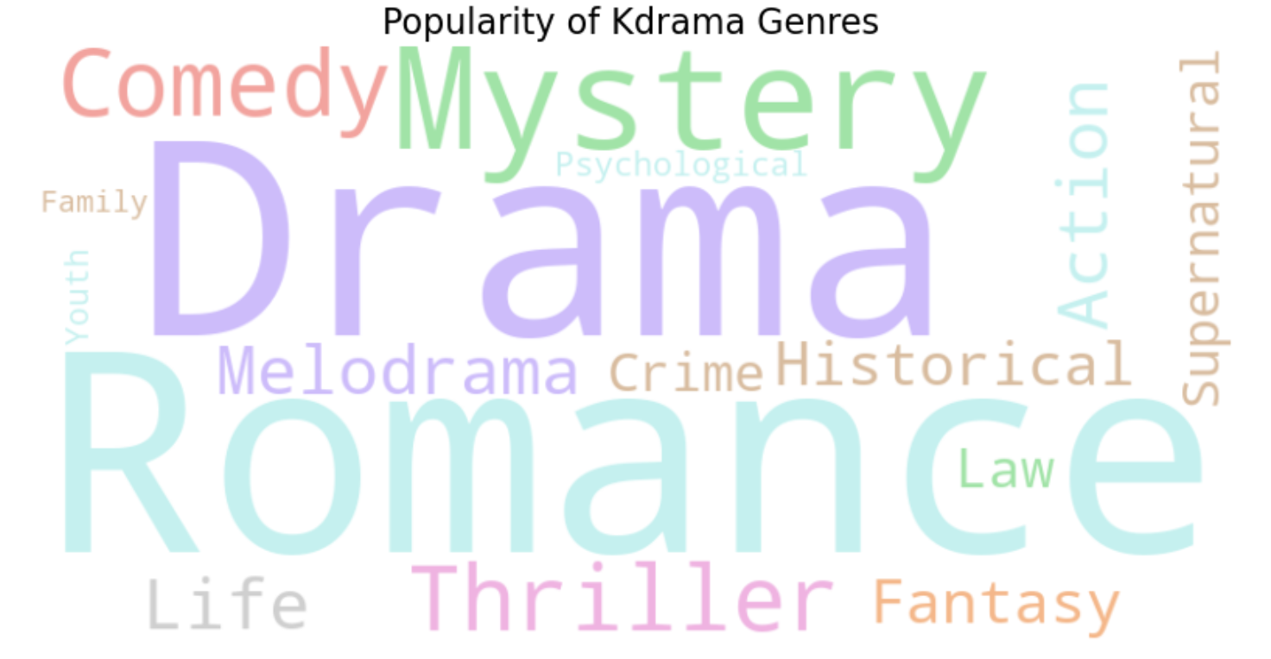
Romance, Mystery, Comedy. Which is your cup of tea?
Notes:
From this word cloud, we can see that the top three genres are romance, drama and mystery. From star-crossed lovers to enemies to lovers, kdramas often leave us swooning. But wait, the drama unfolds with family feuds or corporate power struggles, spicing things up and leaving us glued to the screen. What about mystery? I mean who can resist the twists and turns that keep us on the edge of our seats?
So, what is it about romance, drama, and mystery that captivates us so deeply? Perhaps it's the universal themes they explore – love, betrayal, redemption, and the triumph of the human spirit. Or maybe it's the characters – flawed, complex, and utterly relatable – who remind us of ourselves, our dreams, and our deepest desires.

Slide 8
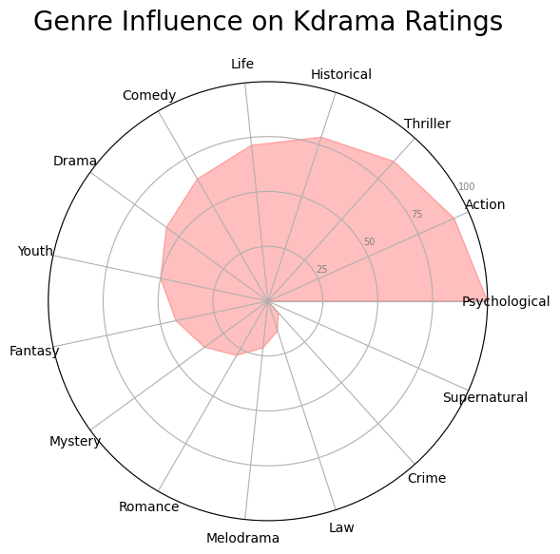

Thrills + Action + Cliffhanger
=
Higher Rating?
BUT…

Slide 9
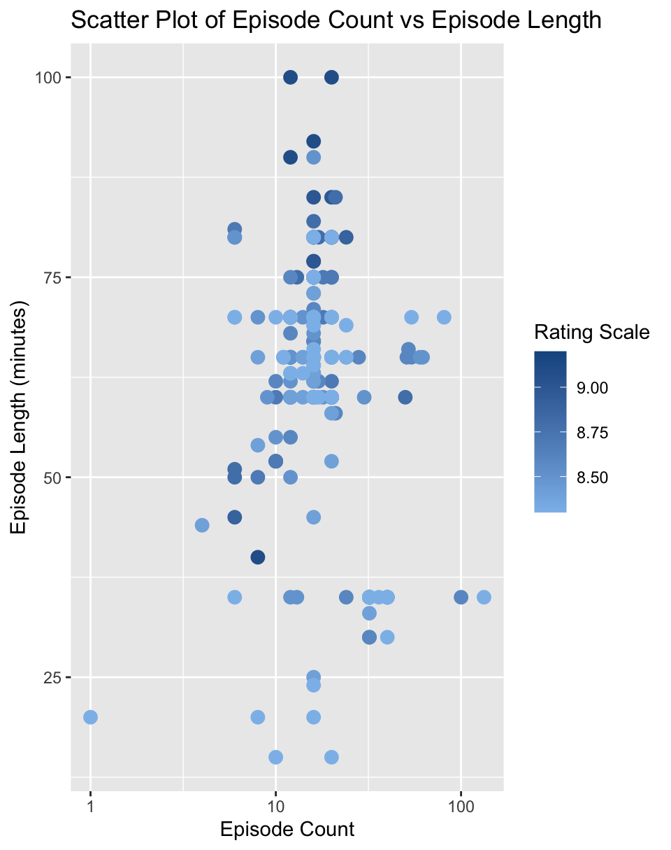
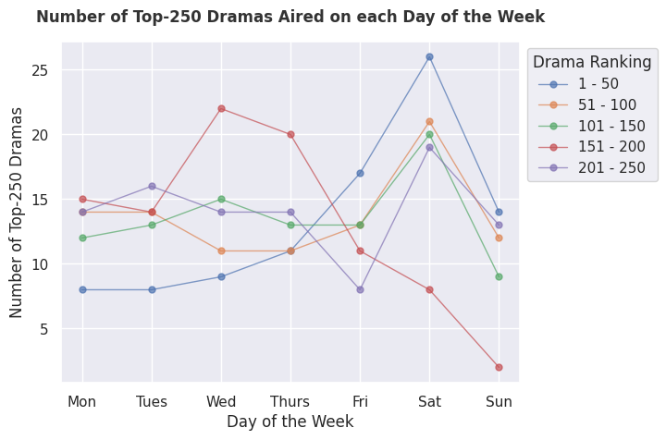
Weekends vs Weekdays
When should you air your drama to boost popularity?
Are we easily bored?
Or do we want more?

Slide 10
Recommendation System
Feature Extraction
System extracts relevant features from available data
Vector representation
Each K-drama is represented as a vector in a multi-dimensional space, with each dimension corresponding to a specific feature
Similarity measure
Calculate the likeliness between vectors representing different K-dramas
Recommendation Generator
Based on similarity scores, system generate personalized recommendations

Slide 11
Recommendation System
No. of episodes
Genre
Tags
Cast
TF-IDF vectorizer
Word Weightage
Cosine similarity
Top 5 Recommended Dramas

Slide 12
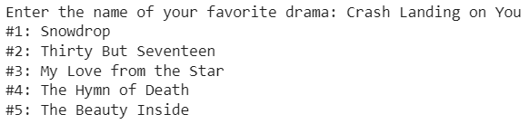
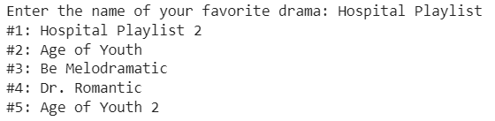
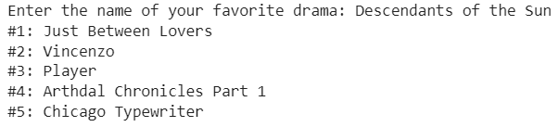
Recommendation System
Colab Link

Slide 13
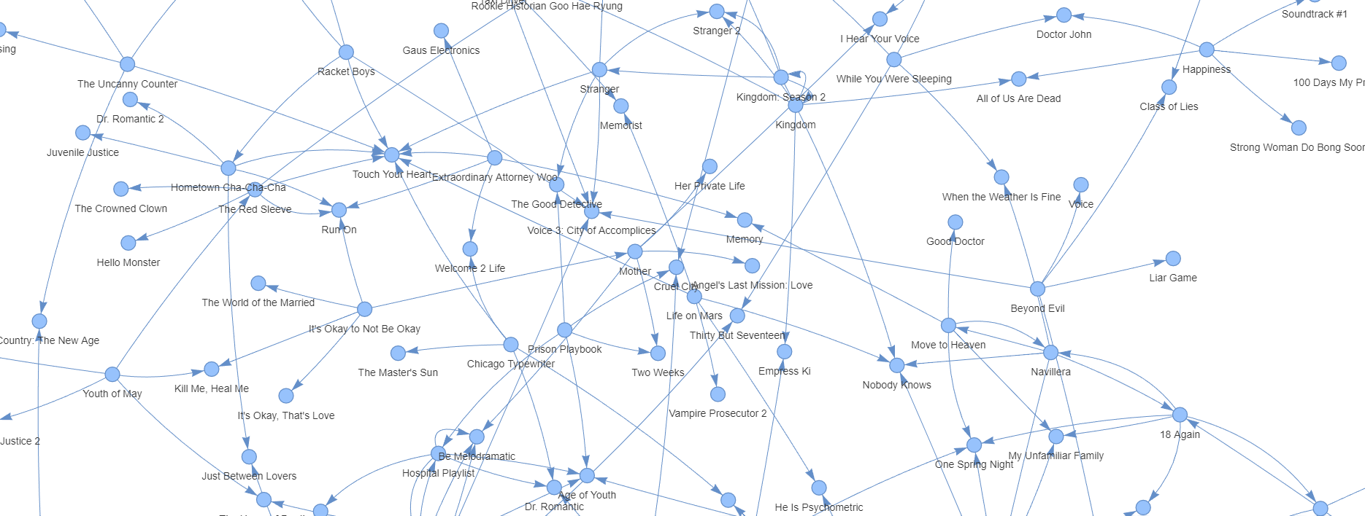
Graph Network of Top 50 Dramas

Slide 14
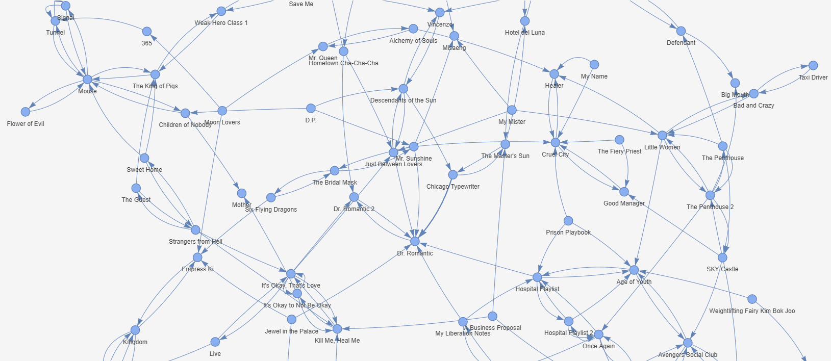

Slide 15

Thank You!

